Slide 1

PROGRAMMING FUNDAMENTALS
FALL 2023

Slide 2

WEEK 4

Slide 3
COVERED IN WEEK 3
LEC 5 & 6
Structure of c
Variable
Constant
Arithmetic operator
White spaces
comments
Already done !

Slide 4
This Week Goals
Char ……… ascii
Escape sequences
(conversion or format) Specifiers
Scanf
Short int,int, long int, long long it, float, double , long double
Assignment & other operators
Notes:
Both long int x; and long x; are valid ways to declare a long integer variable, but the former is more explicit and recommended for clarity and readability.

Slide 5
Read your self if so curious , no need to memorize
Why use %d and not %i ?
https://stackoverflow.com/questions/1893490/what-is-the-difference-between-conversion-specifiers-i-and-d-in-formatted-io-f

Slide 6
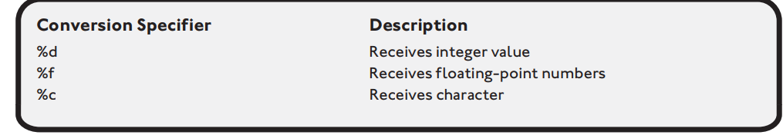
The scanf() function is another built in function provided by the standard input output library ; it reads standard input from the keyboard and stores it in previously declared variables. scanf("%d", &abc);
The name stdio.h is short for standard input output header file

Slide 7
Home task :Can we take multiple inputs using single scanf ?
And of different datatypes ?

Slide 8
Data types

Slide 9
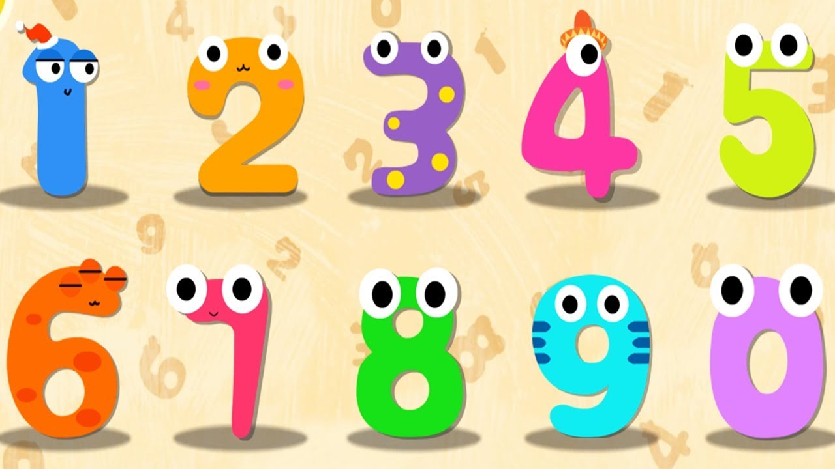
integer
Integers are whole numbers that represent positive and negative numbers, such as 3, 2, 1, 0, 1, 2, and 3, but not decimal or fractional numbers.
int x,y;

Slide 10
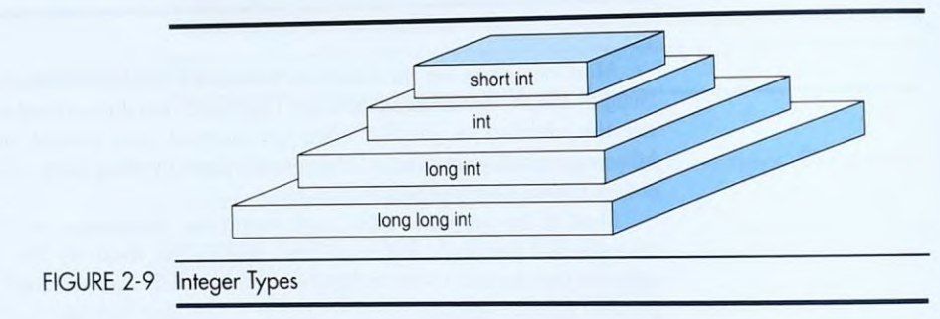

Slide 11
float
Floating-point numbers are all numbers, including signed and unsigned decimal and fractional numbers. Signed numbers include positive and negative numbers whereas unsigned numbers can only include positive values. Examples of floating-point numbers are shown in the following list.
• 09.4543
• 112.34329
• -342.66
• -55433.33281

Slide 12
float: Single-precision floating-point type.
double: Double-precision floating-point type.
long double: Extended precision floating-point type.

Slide 13
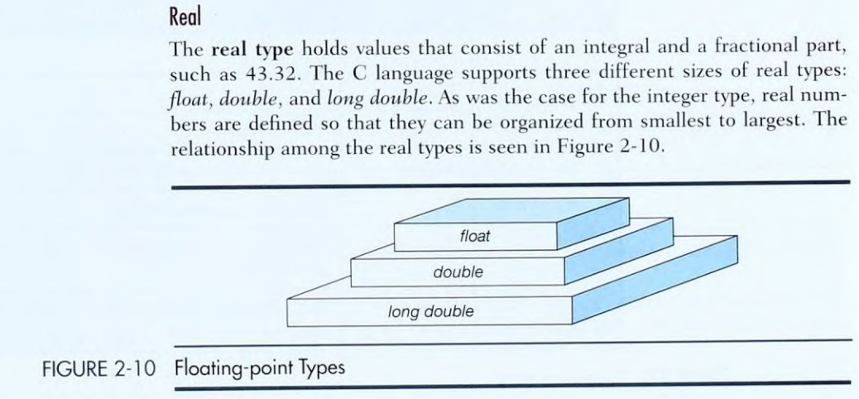

Slide 14
FLOAT: Single-precision floating-point numbers have 32 bits of storage and typically provide around 6-9 decimal digits of precision. This means they can represent real numbers with roughly 6-9 significant decimal places.
DOUBLE: Double-precision floating-point numbers have 64 bits of storage and offer higher precision compared to float. They usually provide around 15-17 decimal digits of precision, making them suitable for most scientific and engineering calculations.
LONG DOUBLE: Long double is an extended precision floating-point type that can vary in size and precision depending on the compiler and platform. On some systems, it can provide significantly more precision than double, offering up to 18-21 decimal digits or more.

Slide 15
#include <stdio.h>
int main() {
float ff = 1.23456789; // Single-precision float
double dd = 1.23456789012345; // Double-precision float
long double ldd = 1.23456789012345678901234567890; /* Long double (extended precision) */
printf("Float f: %.9f\n", ff); // Print with 9 decimal places
printf("Double d: %.14lf\n", dd); // Print with 14 decimal places
printf("Long double ld: %.30Lf\n", ldd); // Print with 30 decimal places
return 0;
}
RUN THIS CODE AND UNDERSTAND BY MAKING CHANGES TO IT

Slide 16
HOME TASK
CAN WE ADD FLOAT TO INT ?
OR ADD OR SUBTRACT INT AND DOUBLE ?
CAN WE ADD CHAR AND CHAR ?

Slide 17
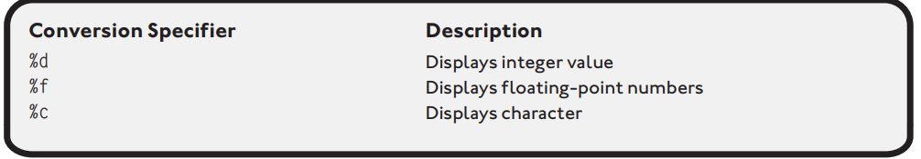
Used in printf
Conversion specifier or format specifier

Slide 18
Home task
What are format specifiers for short int , long int , long long int , double , long double ?
MUST PRACTICE IN COMING LAB

Slide 19
CHARACTER
Characters represent more than just the letters of the alphabet; they also represent numbers 0 through 9, special characters such as the asterisk (*).
In all, there are a total of 128 common character codes (0 through 127), which make up the most commonly used characters of a keyboard.
char first_letter , second_letter ;
first_letter = 'M’;
Character data assigned to character variables must be enclosed in single quotes.

Slide 20
#include <stdio.h>
int main() {
char a,b,c,d,e;
a='T';
b='t';
c='#';
d=45;
e='5';
printf(" %c \n %c \n %c \n %c \n %c ", a, b, c,d,e);
return 0;
}

Slide 21
Learn from IICT LAB
What is ANSI ?
What is ASCII ?

Slide 22
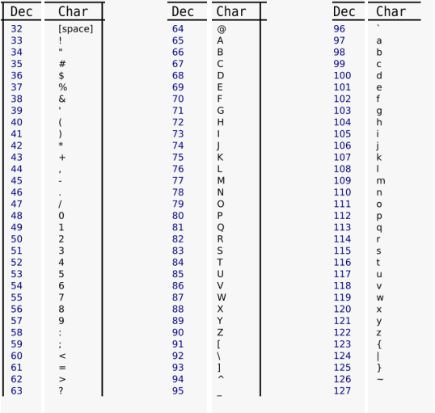

Slide 23
#include <stdio.h>
int main() {
char character = 'A'; // Change this to the character you want to get the ASCII value of
printf("The ASCII value of %c is %d\n", character, character);
return 0;
}
Single quotes were not needed here

Slide 24
#include <stdio.h>
int main() {
char symbol1 = 64; // ASCII value 64 corresponds to '@'
char symbol2 = 35; // ASCII value 35 corresponds to '#'
char symbol3 = 36; // ASCII value 36 corresponds to '$'
printf("Special Symbols:\n");
printf("Symbol 1: %c\n", symbol1);
printf("Symbol 2: %c\n", symbol2);
printf("Symbol 3: %c\n", symbol3);
return 0;
}
Practice in lab or by your self

Slide 25
literal
A literal is an unnamed constant used to specify data.
a=b+5 ;
Here 5 is literal.

Slide 26
ESCAPE SEQUENCE
The backslash character (\) is the escape character. When the printf() statement shown above is executed, the program looks forward to the next character that follows the backslash.
An escape sequence in C language is a sequence of characters that doesn't represent itself when used inside string literal or character.

Slide 27
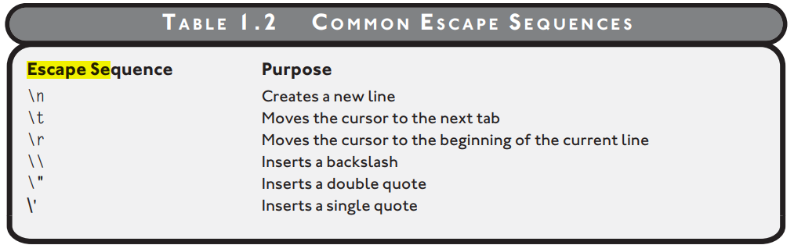
ESCAPE SEQUENCE
Practice in lab or by your self

Slide 28
Assignment operators
++
--
=
+=
-=

Slide 29
equal sign (=) is an assignment operator, where the right side is being assigned to the left side of the operator (=).

Slide 30
increment
The ++ operator is useful for incrementing number-based variables by 1.
x++;

Slide 31
Home task
Can a character be incremented ?

Slide 32
For now think of
++x as x++ , same for --

Slide 33
+=
The += operator is also considered an assignment operator.

Slide 34
#include <stdio.h>
main() {
int x = 1; int y = 2;
x = y * x + 1; //arithmetic operations performed before assignment
printf("\nThe value of x is: %d\n", x);
x = 1; y = 2;
x += y * x + 1; //arithmetic operations performed before assignment
printf("The value of x is: %d\n", x);
} //end main function
Demonstrating order of operations, the program above outputs the following text.
The value of x is: 3
The value of x is: 4
Practice in lab or by your self

Slide 35
WEEK 4 (LEC 8)

Slide 36
Functions
Understand not memorize
Structured programming enables programmers to break complex systems into manageable components. In C, these components are known as functions.
Functions allow you to group a logical series of activities, or program statements, under one name.
Functions can take in and pass back information.

Slide 37
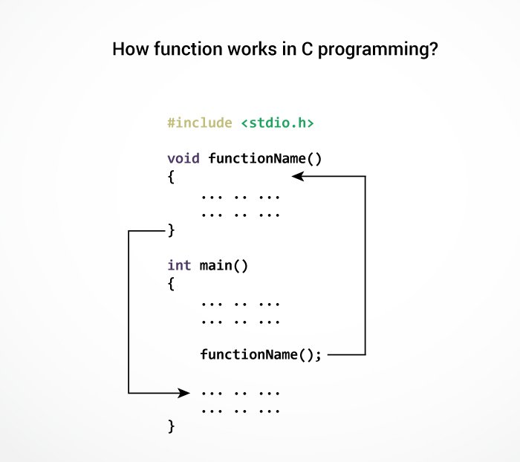

Slide 38
Recall example of addition function taught in class ?
Practice it your self.

Slide 39
READ FOLLOWING EVEN IF YOU DON’T understand, don’t worry we will study in next week ,but it d helps
Structured programming enables programmers to break complex systems into manageable components.
Code reusability is implemented as functions in C.
Information hiding is a conceptual process by which programmers conceal implementation details into functions.
Function prototypes tell C how your function will be built and used.
It is common programming practice to construct your function prototype before the actual function is built.

Slide 40
Function prototypes tell C the data type returned by the function, the number of parameters received, the data types of the parameters, and the order of the parameters.
Function definitions implement the function prototype.
In C, functions can return a value to the calling statement.
To return a value, use the return keyword, which initiates the return value process.
You can use the return keyword to pass a value or expression result back to the calling statement or you can use the keyword return without any values or expressions to return program control back to the calling statement.
Failing to use parentheses in function calls void of parameters can result in compile errors or invalid program operations.
Variable scope identifies and determines the life span of any variable in any programming language. When a variable loses its scope, its data value is lost.
Local variables are defined in functions, such as the main() function, and lose their scope each time the function is executed.
Locally scoped variables can be reused in other functions without harming one another’s contents.
Global variables are created and defined outside any function, including the main() function.

Slide 41



THANK YOU

